Slide 1
Project planning and scheduling

Slide 2
Concept of project planning
In simple sense, planning means thinking ahead of an operation to be performed.
It is primary function of management.
It is deciding in advance
What to do?
When to do?
Where to do?
How to do?
Who is responsible?
It provides the end to be achieved?

Slide 3
Planning is the process by which managers define the goals and take necessary steps to ensure that these goals are achieved. Planning is a mental exercise that requires imagination, foresight and sound judgment. It is thinking before doing, looking ahead, anticipating future and deciding the course of action to be taken. ( Richard Steers )

Slide 4
Features of planning
1. Process: It is systematic mental process of doing things and involves creative thinking and imagination.
2. Future/goal oriented: Planning is essentially thinking ahead and preparing for future. It anticipates future opportunities and threats to the best advantage of the organization. It based in forecasting and environmental scanning. It provides direction to the organization.
3. Intellectual process: Planning is mental exercise involving creative thinking and imagination. A manager can prepare sound plans only when he has sound judgment, foresight and vision.

Slide 5
4. Primary Function: Planning serves as basis for other functions of management. It precedes all other functions of management such as organizing, staffing, leading/directing and controlling.
5. Pervasiveness: Planning is required in all types of organizations and at all levels of management. Every department prepares plan however scope of planning may differ from department to department from one level to another.

Slide 6
6. Continuous: Planning is continuous process. Plans are prepared for specific time period. At the end plan period new plans are prepared. Similarly as the conditions changes the new plans are prepared.
7. Aims at efficiency: Planning is directed towards efficiency at all levels of management. Sound planning leads to accomplishment of desired objectives at minimum possible cost. It helps in organization of resources. Alternatives are evaluated on the basis of efficiency.

Slide 7
Importance of planning
Making objectives clear: Planning makes goal clear and specific. This is because goals are to achieved and decided before choosing the course of action. Planning focuses attention on the organizational objectives and serves as a guide for deciding what action to be taken.
Helps in coordination: Well defined objectives, policies and procedures helps in coordination i.e. it avoids duplication of works and inter department conflict.
Economy and Efficiency in operation: It paves the way for the proper utilization of organization resources. It involves the development of one best way of doing which is economical too.

Slide 8
Reduces risk and Uncertainty : Planning enables to predict future events and prepare to face unexpected events. With the help of planning, managers can identify potential dangers and take steps to overcome them. Thus planning is helpful assessing and meeting future challenges.
Provide the basis of control: Planning provides the standard against which actual performance can be measured and evaluated. Comparison of actual performance with the standard helps to indentify deviation and take corrective actions if necessary.

Slide 9
Facilitates decision making: Planning lays down targets. With the help of these targets managers can be better evaluate alternative course of actions and select the best one. With the help of planning hasty decisions and random actions can be avoided.
Helps in organization to be in right path: Planning helps the organization to keep in right path. Employees understand hoe their actions relates to the organizational goals. Planning avoids aimless and adhoc decisions. It avoids snapshot decisions based on impulse and intuition. Planning provides systematic and orderly efforts towards the goals.

Slide 10
Objectives
Proper design of each element of the project.
Proper selection of plant and equipment.
Proper arrangements of repair of plant and equipment at site.
Procurement of required materials well in advance
Ensure employment of skilled and unskilled employees.
To provide welfare schemes for the workers
To provide incentives for good workers
To arrange constant flow of funds in entire project duration
To provide required level of safety and compensations.
Proper arrangements of communication and mobility in site.

Slide 11
Principle of Planning.
The plan should be readily understandable
The plan should be realistic not an optimistic
The plan should be flexible
The plan should be comprehensive
The plan should incorporate the system of monitoring and controlling.

Slide 12
Concept of Project Planning
According to David I. Clealand : Project planning is the process of thinking through and making explicit the projects’ objectives, goals and strategies necessary to bring the project through its life cycle to successful termination.
The task involved in Project Planning:
Feasibility Study: It determines the implement-ability of the project.
Appraisal: It is the evaluation of Project ability to succeed and done for feasibility.
Design: It is concern with the preparation of detailed engineering design, drawing, specifications as well as detailed engineering plans such as work schedule, cost estimate and resource allocation.

Slide 13
Function of Project Planning
Stating the objectives of the project to be undertaken
Definition of work requirement.
Definition of resource needed such as funds, materials, machines, human resources, facilities.
Determining the time frame of the overall project and also scheduling its various stages.
To eliminate or minimise the risk and uncertainty.
It provides a basis for organizing the work on the project and allocating responsibilities to individuals.

Slide 14
Work break down structure
How many tasks does the project have?
How much detail should the project plan have?
This query is overcome by Work Break Down Structure
Work break down structure as its name suggests represents a systematic and logical breakdown of a project into several components.
It is constructed by dividing a project into major components each of which is further sub-divided into smaller components.
WBS acts as a vehicle for breaking the works into the smaller elements, thus providing a greater responsibility that every major and minor activity are well accounted for their implementation.

Slide 15
Usually the project manager is responsible for structuring a project into several components.
The level of smaller components should be such that each of which should be
Manageable so that specific authority and responsibility can be assigned.
Independent so that there happens to be minimum interfacing with and dependence on other ongoing elements
Integratable so that the total package can be seen
Measurable in terms of progress

Slide 16
Advantages/uses of WBS
Planning can be performed
Costs and budget can be established
Risk analysis can be done
Control and contract administration can be done
Schedules can established
Network analysis can be done
Responsibility matrix can be established
Coordination can be established
When summed up the total program can be described

Slide 17
Roles of WBS
Partition of project into smaller component to improve the accuracy of the cost estimate
Provide mechanism for collecting and organizing actual cost
Provide the mechanism for performance measurement and control.
Each activities in WBS is a self contained unit for which responsibility can be assigned to a person or group for effective management.

Slide 18
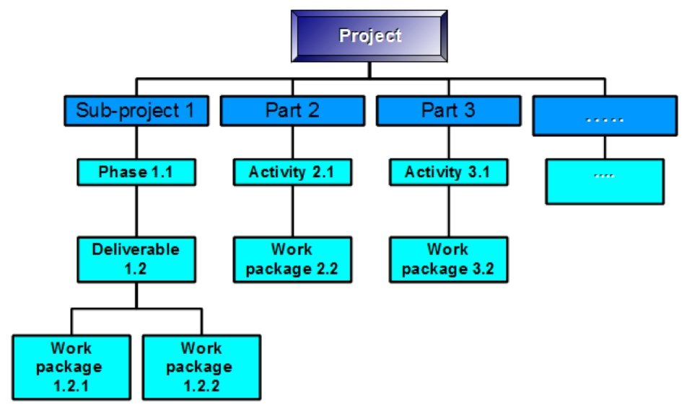

Slide 19
Levels of WBS
Total program
Project
Task ( Activity)
Sub tasks
Work package
Level of effort

Slide 20
Total program = set of projects
Projects= summation of activites
Task = summation of subtask
Level 1 is generally used for the authorization and release of all works budgets are prepared at level 2 and schedules are prepared at level 3
The upper three levels of WBS are normally specified by the project manager office, while lower levels are generated by the contractor for in house control.

Slide 21
Characteristics
Top three levels of the WBS reflect integrated efforts and not department specific
The summation of all elements in one level must be the sum of all work in the next lower level
Each element of work should be assigned to one and only one level of effort. For example the construction of the foundation of a house should be included one project not extended over two or three
The WBS must be accompanied by a description of the scope of effort required.

Slide 22
Preparation of WBS
In setting up WBS tasks should be
Have clearly defined start and end dates
Be usable as a communications tool in which results can be compared with expectations.
Be estimated on total time duration
Be structured so that a minimum of project office control and documentation is necessary.

Slide 23
Criteria for developing WBS
The WBS and work description should be easy to understand
All schedules should follow WBS
No attempt should be made to subdivide work arbitrarily to the lower possible level
Since scope of effort can change during a program every effort should be made to maintain the flexibility in the WBS
The WBS can act as tangible milestone
The level of WBS can reflect the trust you have in certain line groups

Slide 24
Project scheduling with Bar chart, CPM and PERT
Scheduling is laying out of the actual jobs of the project in time order in which they have to be performed, manpower and material requirements needed at each stage of construction are calculated, along with the expected completion time of each jobs.
Scheduling is used for following proposes.
To control financing and payment
To predict project completion time and activity
To serve as a record
To manage risk and uncertainties.

Slide 25
Project scheduling methods
1.Bar chart
1.1 Gnatt chart
1.2 linked bar chart
1.3 milestone chart
2. network diagrams
2.1 CPM ( Critical Path Method )
2.2 PERT ( Program Evaluation and Review Technique)

Slide 26
Bar chart/ Gantt chart
It is graphical representation of project activities shown in time scale bar line with no links shown between the activities.
A bar chart is a scheduling technique in which activity during is drawn to scale on a time base.
A bar chart is also called Gantt chart since it was developed by Henry Gantt.

Slide 27
Steps in preparing Bar chart
Listing the work of activities
Estimation of work duration
Identifying the start and completion date in calendar format
Drawing each activity as horizontal bar in chronological order according to its start date

Slide 28
Advantages of Bar Chart
Easy to understand
The status of the project can be assessed in short time
Easy to develop and implement
No training is required
Appropriate for small project
Starting point for planning

Slide 29
Disadvantage of bar chart
Not suitable for big and complex project.
Difficulties in seeing immediately and exactly overall project duration if changes occur in any particular activity.
No detail but gross planning
It does not show specifically which activities to control and expedite and how much
It does not depict the dependencies of activities upon each other.
Updating means to redraw the entire chart again and again
Do not provide the methods for optimizing resource allocation
It is difficult to show critical path critical activities and floats available.

Slide 30
Linked bar chart
It is modified version of Gantt bar chart. It was developed to overcome some of the inherent limitations of bar chart.
It shows the links between an activity and preceding and succeeding activities.
The link bars are very complicated ad sometimes impossible to show graphically. They are mainly four types of relationship between activities.

Slide 31
Finish to Start
Activity Y can’t start until activity X is finished
X Y
Start to Start
Activity Y must start when activity X start
X
Y
Start to finish
Activity Y should be finished when activity X starts
X
Y

Slide 32
Finish to Finish
Activity Y must be finished when activity X finishes
X
Y
The linked bar chart has an advantage of exhibiting the effect of delay on succeeding activities and also it can provide some information of the extra time available with an activity for its completion
The extra time available for activity for its completion is called float.

Slide 33
Milestone Chart
Milestone chart is an improved version of a bar chart in which some of the limitations of the bar chart are eliminated.
Bar charts are converted into the milestone bar chart by placing small triangles or circles or flag at strategic locations of bar to indicate the completion at certain milestone within each activity or group of activities.
A milestone implies some specific stage or point where major activity either begins or ends or cost data become critical.

Slide 34
Each bar in a milestone chat again represents an activity or job or task and all the bars taken together represent the entire project.
A milestone chart shows the relationship within same activity or job or task.
Thus as compared to bar chart better control can be achieved with the help of milestone chart but still possesses the same deficiency that it does not depict the interdependencies between the various tasks or relationship between the milestones of different task.

Slide 35
Network Diagrams
There are two popular network based scheduling Techniques
Critical Path Method ( CPM )
Program Evaluation and Review Technique (PERT)
Critical path is graphical network base scheduling technique that evolved in late 60’s US agencies insisted on their use by contractors on major government projects.
Basic concepts of CPM such of activities, events and predecessors have become a regular part of language of project managers

Slide 36
CPM enables planners and managers to thoroughly analyze the timing and sequential logic of all operations required to complete the project.
In 1957 CPM was developed by Morgan R. Walker of DU Pont and James E. Kelly of Remington Rand for preparing the shut down schedule of chemical plant.
US navy developed the project management tool known as PERT ( 1958 ) for Polaris Missile project

Slide 37
Activity
An activity is an any identifiable job that has a beginning and end.
An activity consumes time, manpower and material resources.
Examples: excavation of foundation.
Construction of walls
Construction of roofing
An activity is represented by a straight arrow with circles at both ends ( ).

Slide 38
The circle placed at the beginning of the arrow represents the starting point of the activity while the circle placed at the end of the arrow represents the finishing point of the activity.

Slide 39
Event
An event ( also called Node) is the beginning or end of the activity.
An event does not consume time, manpower or material resources.
An event represents a specific point in time and is represented by the circle.
Thus the two circles placed at the beginning and end of the activity are called events.

Slide 40
Event 1 is tail event eg. Start of Earthwork in Excavation
Event 2 ( completion of Excavation ) is head event of the activity earth work in excavation and tail event for activity construction of wall. It is called dual role event
Event 3 is the head event for activity construction of wall.
A
B
1
2
3
15
21

Slide 41
Dummy activity
A dummy activity is an imaginary activity included in the network.
Since it is not a real activity it does not consume time manpower and material resources.
It is included in the network to maintain the network logic and to avoid the ambiguity.
A dummy activity is represented by dotted arrow.
Unnecessary dummies make network messy and creates confusion.

Slide 42
Activity duration
Activity duration is the amount of time estimated for its completion.
The time unit for the project can be minutes, hours, working days or calendar days,

Slide 43
Earliest time and latest time
There are following types of earliest and latest time.
Earliest start time: It is the earliest possible time an activity or operation can be started.
Earliest Finish Time: It is the earliest possible time for completion of activity or operation
Latest finish time: It is the latest time the activity or operation must be completed so that scheduled completion date of work can be achieved.
Latest Start Time: It is the latest the possible time an activity can be started without delaying the project.

Slide 44
D= activity duration
EFT= EST ( 1-2) + d
LST = LFT ( 1-2 ) –d
d
1
2

Slide 45
Rules of Drawing Network Diagram
All activities shall be represented by way of straight arrows pointing towards right
There must be single initial node as well as ending node in a network . The initial node has only outgoing arrows where as ending node has only incoming arrows.
There shall not be crisscrossing of arrows
The arrows of a network can’t form loops
There shall not be unnecessary dummy activities in the network. Dummy activities shall be introduced only when absolutely necessary.

Slide 46
Numbering of Events ( Fulkerson’s Rule)
Identify the initial event and assign it no.1
Neglect all the emerging arrows from initial event 1. this will create a new initial event. Number these initial events as 2,3,4 etc.
Neglect all the emerging arrows from these numbered events, it will create few more initial events.
Follow the above procedure till the end of the network is reached. The last event is assigned with the highest number in the network.

Slide 47
Skip Numbering
In large projects all the activities cannot be correctly foreseen and included in the network. It may need modification in the form of addition and/or deletion of activities during execution. Tedious task of numbering is the events after modification can be avoided by numbering the events in multiple of 10s ( 10,20,30 ) instead of 1,2,3. this method is called skip numbering.

Slide 48
Activities on Node ( A-O-N )
It uses circles to represent the project activities with an arrow linking them together to show sequence in which they are to be performed.
In AON method dummy activity is omitted ad does not require to show EST and LFT directly network.
AON is also known as Precedence Diagram Method ( PDM )

Slide 49
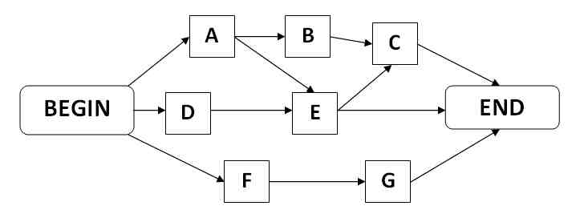

Slide 50
Critical Path Method ( CPM )
A network represents the logical sequence of activities contained in an each path in a network will have a different duration.
The path that have a longest duration is called critical path and the activities in the critical path are called critical activities.
The critical path sets the overall duration of the project.

Slide 51
Characteristics of Critical Path
A critical path is longest path time( time-wise) connecting the initial and final events.
A critical path may run through dummy activity/ activities.
Since critical path is the path having the longest time duration, it does not mean it will have maximum number of activities.
It is possible that a network may have more than one critical path. i.e. if two paths have the same time duration which is maximum then such paths will be the critical paths.
It determine the total project duration.

Slide 52
Finding critical path in a large network
Forward pass computation
All activities in the network are assumed to start as early as possible.
Calculation begins from left to right side of network.
When two or more than two activity merge into an event, the largest value is taken as an earliest occurrence of the event.
It gives EST and EFT of each activity.

Slide 53
Backward pass computation.
All activities in the network are assumed to start as late as possible.
Calculation begins right to left side of network.
When two or more than two activity merges to event, the smallest value is taken as late occurrence of time of event.
It gives LST and LFT of each activity.

Slide 54
Activity float analysis
For the events that lie on the critical path, the EST and the LFT are equal. In other words slack of the these events is given by i.e.
Slack = EST –LFT
The free time available for the activity is called float. Thus float for an activity is similar to the slack of event.
There are four types of float.
Total float
Free float
Independent float
Interfering float

Slide 55
Total float:
Total float represents the maximum time by which the completion of an activity can be delayed without affecting the project completion time.
If an activity is delayed by the time equal to its total float, that activity and all the other subsequent activities in that path become the critical activities.
Total float of the activity = LFT of head event- EST of tail event –duration or LFT –EFT or LST -EST

Slide 56
Free Float
Free float of an activity is the delay that can be permitted in an activity so that succeeding activities in the path are unaffected.
Free float of an activity= EST of head event – EST of tail event – duration < TF
Independent float
Independent float of an activity is the spare time available for that activity, if that activity is started as late as possible and is finished as early as possible.
Independent float of an activity = EST of the head event –LFT of tail event - duration
Interfering float
It is the difference between Total float and free float

Slide 57
Use of different floats for management decisions
All activities that lie in the critical path have their total floats equal to zero.
If the total float of an activity is used entirely in that activity, it would make that activity and all the succeeding activities in the path critical. Hence it is not advisable to use the total float completely in an activity as this will leave cushion available if subsequent activities need additional time for completion than originally planned.

Slide 58
Free float can be used completely for the activity since this does not disturb the succeeding activities. However preceding activities should be finished as planned.
Independent float of an activity since this doesnot disturb succeeding activities. Hence independent float can be used without any constraints.

Slide 59
Advantages of critical path method
It makes dependencies variable
It enables the calculation of float of each activity.
It encourages the project manager to reduce the project duration.
It enables the project manager to optimise efficiency
It provides opportunities to the respond to the negative risk going over schedule.

Slide 60
Disadvantages
For large and complex projects, there will be the thousands of activities and dependency relationships. Without the software it might be difficult managing this
It may be difficult to print the project network diagram with thousand of activities
It doesnot account resource levelling and resource allocation.

Slide 61
PERT ( Program evaluation and Review Technique
Like CPM, PERT is also a network based planning tool developed by US Navy in 19856/1957 and used for scheduling Ballistic Missile Project, Launching Nuclear Missile from sub-Marine
But unlike CPM, Pert is used for novel projects like research and development where it is difficult to estimate the experience such as civil engineering works.
It is probabilistic approach for estimating the duration of an activity and event oriented network diagram.

Slide 62
PERT uses three time estimate
Optimistic time estimate
Pessimistic time estimate
Most likely time estimate

Slide 63
Optimistic Time Estimate ( t_{o} )
It is the minimum time required to complete the activity in ideal situation.
In arriving the Optimistic time estimate, it is assumed that everything is favorable in completing the activity in the shortest possible time.
Pessimistic time estimate ( t_{p} )
It is the maximum time required to complete the activity in the worst situation
In arriving the pessimistic time it is assumed that everything is unfavorable for completing the activity in time and every possible delay and situation is encountered.

Slide 64
Most likely ( probable ) time estimate ( t_{m} )
It is the time required to complete the activity in normal circumstances.
In arriving the most likely time it is assumed that conditions are neither favorable nor unfavorable but normal
Expected time estimate: ( t_{e} )
From these three time estimates, we calculate the average time ( expected time )
t_{e} = [t_{o} +4t_{m} + t_{p} ]/6
S.D.= [t_{p} – t_{o} ]/6
Variance = S.D. ²

Slide 65
Difference between Cpm and Pert
CPM | PERT
Deterministic tool with single estimate of duration | Probabilistic tool used with three estimate of duration
Activity oriented | Event oriented
Considers less uncertainty | Considers more uncertainty
Best suited for routine projects requiring accurate time and cost estimates | Best suited for research and development related projects where the project is performed for the first time and estimates of the duration is uncertain
Allows and explicit estimate of cost in addition to time, therefore CPM can control both time and cost | This tool is basically a tool for planning and controlling of time
The deterministic factor is more so values or outcomes are generally accurate and realistic | The probability factor is major in PERT so outcomes may not be accurate
Easy to maintain | Costly to maintain

Slide 66
Similarities between CPM and Pert
Both tools lead to the same end : critical path and critical activities with slack time equal to zero
Extensions of both PERT and CPM allow the user to manage other resources in addition to time and money, to trade off resources, to analyse different types of schedules and to balance the use of resources.

Slide 67
Probability of completing the projects in Given time
It is assumed that the project completion time follows the normal distribution. The area under the normal curve between mean and any point x which is one standard deviation away from the mean is always same irrespective of the values of mean and standard deviation.
The term one standard deviation can be replaced by any standard deviation and the statement still holds good.
If z is the number of standard deviation away from the mean for an observation z can be represented as
Z= [ observed value- mean value]/ standard deviation

Slide 68
Resource leveling and resource smoothing
Planning with limited resources
In real life project it is a common experience that the resources are frequently in a limited supply causing delay in completion of project.
In some cases particular material or some machinery may not be available in the middle of the project . Availabilty of the fund may be restricted. Due to this following constraints are imposed
Starting of the activity is delayed
Non- critical jobs may be critical due to start in delaying
More than one type of resource may be scarce in the middle of performance of a particular job.

Slide 69
Resource leveling and resource smoothing
Reduce peak resource requirement at undesirable times and smooth out period to period assignment is called resource leveling. It is done by moving project activities.
If any non critical activities are shifted so that the project duration does not increase then it is called time limited resource leveling or simply resource leveling. But if critical activities are also shifted along the non critical activities it is called resource smoothing.
Resource leveling is necessary to
Implement the project effectively
To reduce the cost of project

Slide 70
